Slide 1
Introduction to BigData – Spark – Processing Concrete Examples Experience at SG
Arnaud Nauwynck
Oct 2022
@Copyright All rights reserved

Slide 2
Objectives
4 x 2 hours of lessons
4 x 2 hours of Hands-On
Objective Lesson 1 : Overview
What is BigData ?
What is Spark ?
What is Data processing ?
… concrete examples from experience in a company
Objective Lesson 2,3,4 : Deep Dive in Spark

Slide 3
Outline
What is BigData ?
Order of Magnitudes for « Big »
History
Evolution of Softwares, Spark
Description of a Datalake
Content, data feeding
How it is organized
Who uses it
Example of Data-Processing
RAW to LAKE, Reports
Change Storage-Compute, Evolution to Cloud

Slide 4
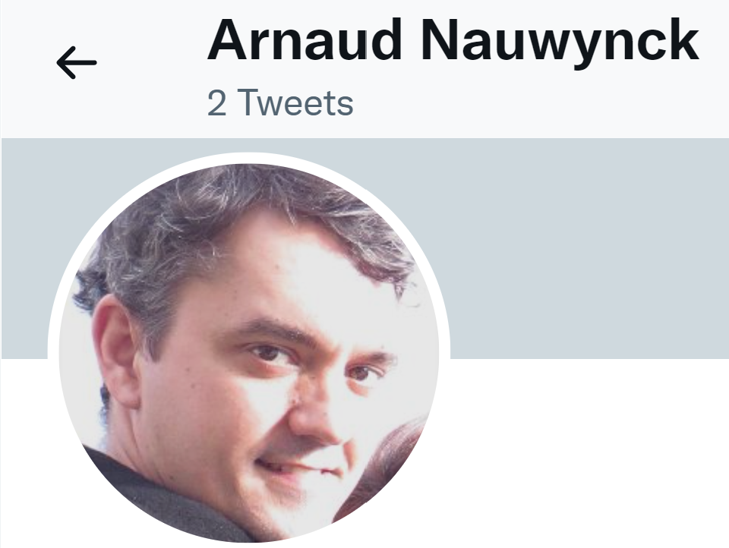
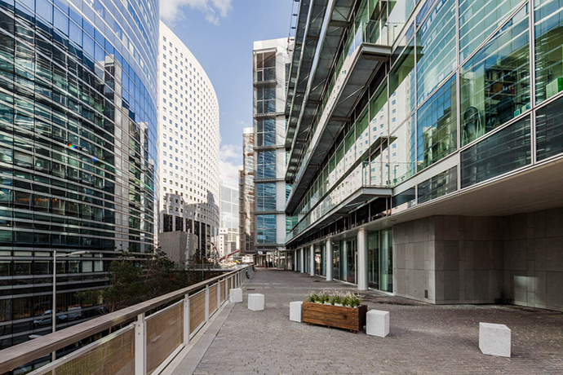
About Me
NOT using Twitter/LinkedIn/FaceBook/
Only
arnaud.nauwynck@gmail.com
IT Passionate since 20 years
Working at Société Générale (La Defense)
In BigData team since 4 years
Expert Java + BigData + more
Github repos
https://github.com/Arnaud-Nauwynck
http://arnaud-nauwynck.github.io/

Slide 5
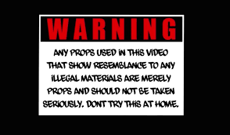
DISCLAIMER I do not know everything. I am biaised with what I know. My opinions do not represent any company

Slide 6
About You … Quick Survey ?
Raise your Hands…
You are developper ?
In Java ? SQL ?
You know Hadoop / Hdfs / Spark ?
You want to be Data Engineer / Data Scientist ?

Slide 7
Outline
What is BigData ?
Order of Magnitudes for « Big »
History
Description of a Datalake
Content, data feeding
How it is organized
Who uses it
Example of Data-Processing
RAW to LAKE, Reports
Change Storage-Compute, Evolution to Cloud

Slide 8







How Big ? => Then Which Tool
1 .. 1 000
50 000
1 Million (e6)
( Mega Bytes)
1 Billion(e9)
( Tera Bytes)
>= e9 : BIG Data
( Peta Bytes)

Slide 9
Compute Resources Vertical Scaling
Historically: have Bigger needs => buy BIGGER Server
Very Frequent in Bank OLTP Databases
128 cores x 500Go RAM + SAN Bay of Disks
= Millions of Euros
.. BUT price is exponential to performance, and limited

Slide 10
BigData definition
Data does not fit on 1 server … even Huge, because of
3 V = Volume / Velocity / Variety

Slide 11
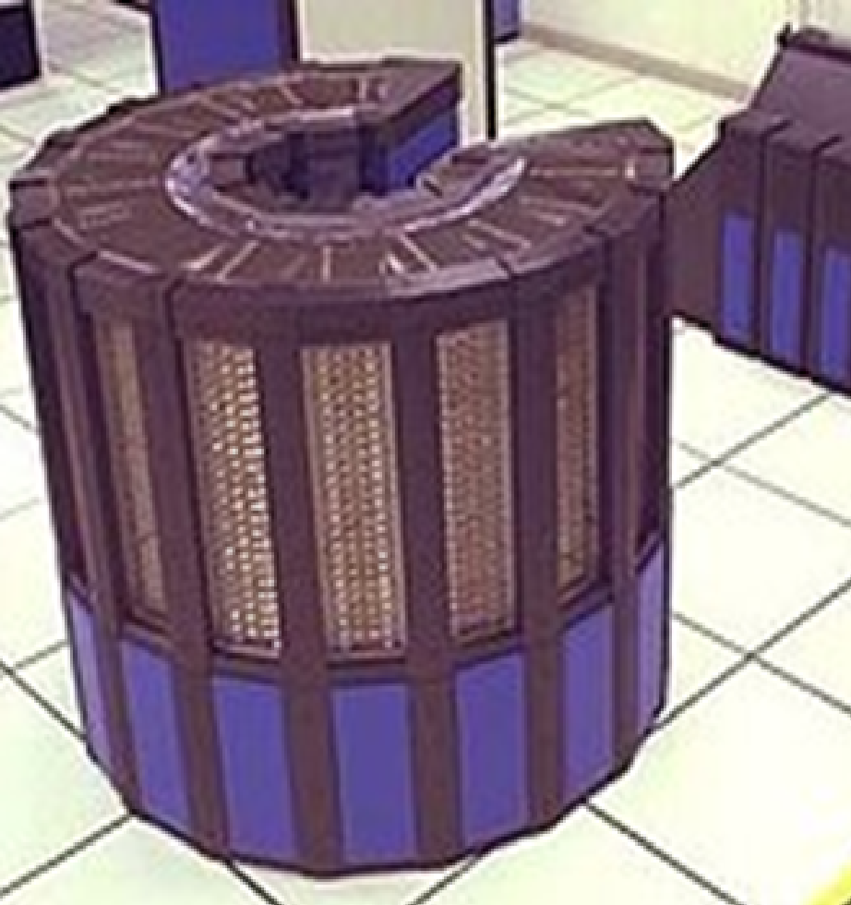
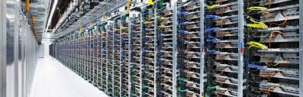
Bigger Hardware, different Software
Vertical Scaling -> Horyzontal
1 OS, 1 process, N Threads
Distributed computing
… Sotfwares need
Network, Fault Tolerant

Slide 12

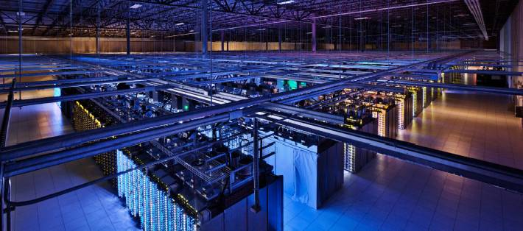
BigData At Scale Google Datacenter

Slide 13
Not Only Gafas
Example of Smaller Companies, obviously doing BigData
Criteo (internet advertisment)
Cern (particule accelerators)
Gouvernment
Social Networks
Auchan, Carrefour, .. (E-Commerce)
MeteoFrance ( Computing, Satelite Images)
Uber, Taxis, Cars ( IOT )
Medical, Pharmaceutic, Genetics
Industries
Banks
..

Slide 14
BigData In Banks ?
Corporate Investment Bank
Network Bank (for everybody customers)
(for private / owned trading )
Example of Société Genérale:
At La Defense
Example of Société Genérale:
At Val de Fontenay
Data for
Historical Market datas
Risk / Var management
Aggregation of all Trading departments
Regulatory Reporting
Business analysis
..
Data for
RGPD… warn personnal data!
Anti Fraud detection,
customers-oriented
Business analysis
..

Slide 15
BigData at SG (Investment Bank)
PROD Cluster
>= 3 Petas of Data
( 9 petas of Disks,
with replicationFactor=3)
+ DEV Cluster
.. Containing backups of PROD Data
+ others
Clusters

Slide 16
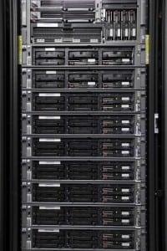
Typical Datacenter Hardware = N Racks x 10 blades (1U / 2U)

Slide 17
Example of a Server for Datalake
1 server = 42 cores + 256 Go RAM + 8 disks + network 1Gb/s

Slide 18
« Small » Datalake ?
100 servers for PROD
( + 120 servers for DEV )
= 4200 cores
+ 25600 Go RAM : 25 Tera of RAMS
+ 800 disks : 2 Petas of Data ( 6 peta of Disks )
… now 3 Petas on Azure

Slide 19


Hadoop Cluster Architecture
Firewall
2 Main HeadNode Server
(NameNode, Oozie, Yarn..)
Allow Https Hadoop APIs
(Knox, Oozie, Yarn,
Hdfs, Hive Hue, Ambari..)
LoadBalancer
100 DataNodes
Allow SSH
On « Edge » Node for command line oozie, yarn, Spark, ..
Postgresql for
Oozie,Yarn,Ranger, Hive Metastore..
$ _
8 Kafka Brokers
For streaming
Kafka, Jms, tibcoEMS
Flume + http front
Installed Hadoop Distribution
http for ADMIN (Internal APIs)

Slide 20
How Softwares evolve to handle all this ? Which ones to use today?

Slide 21
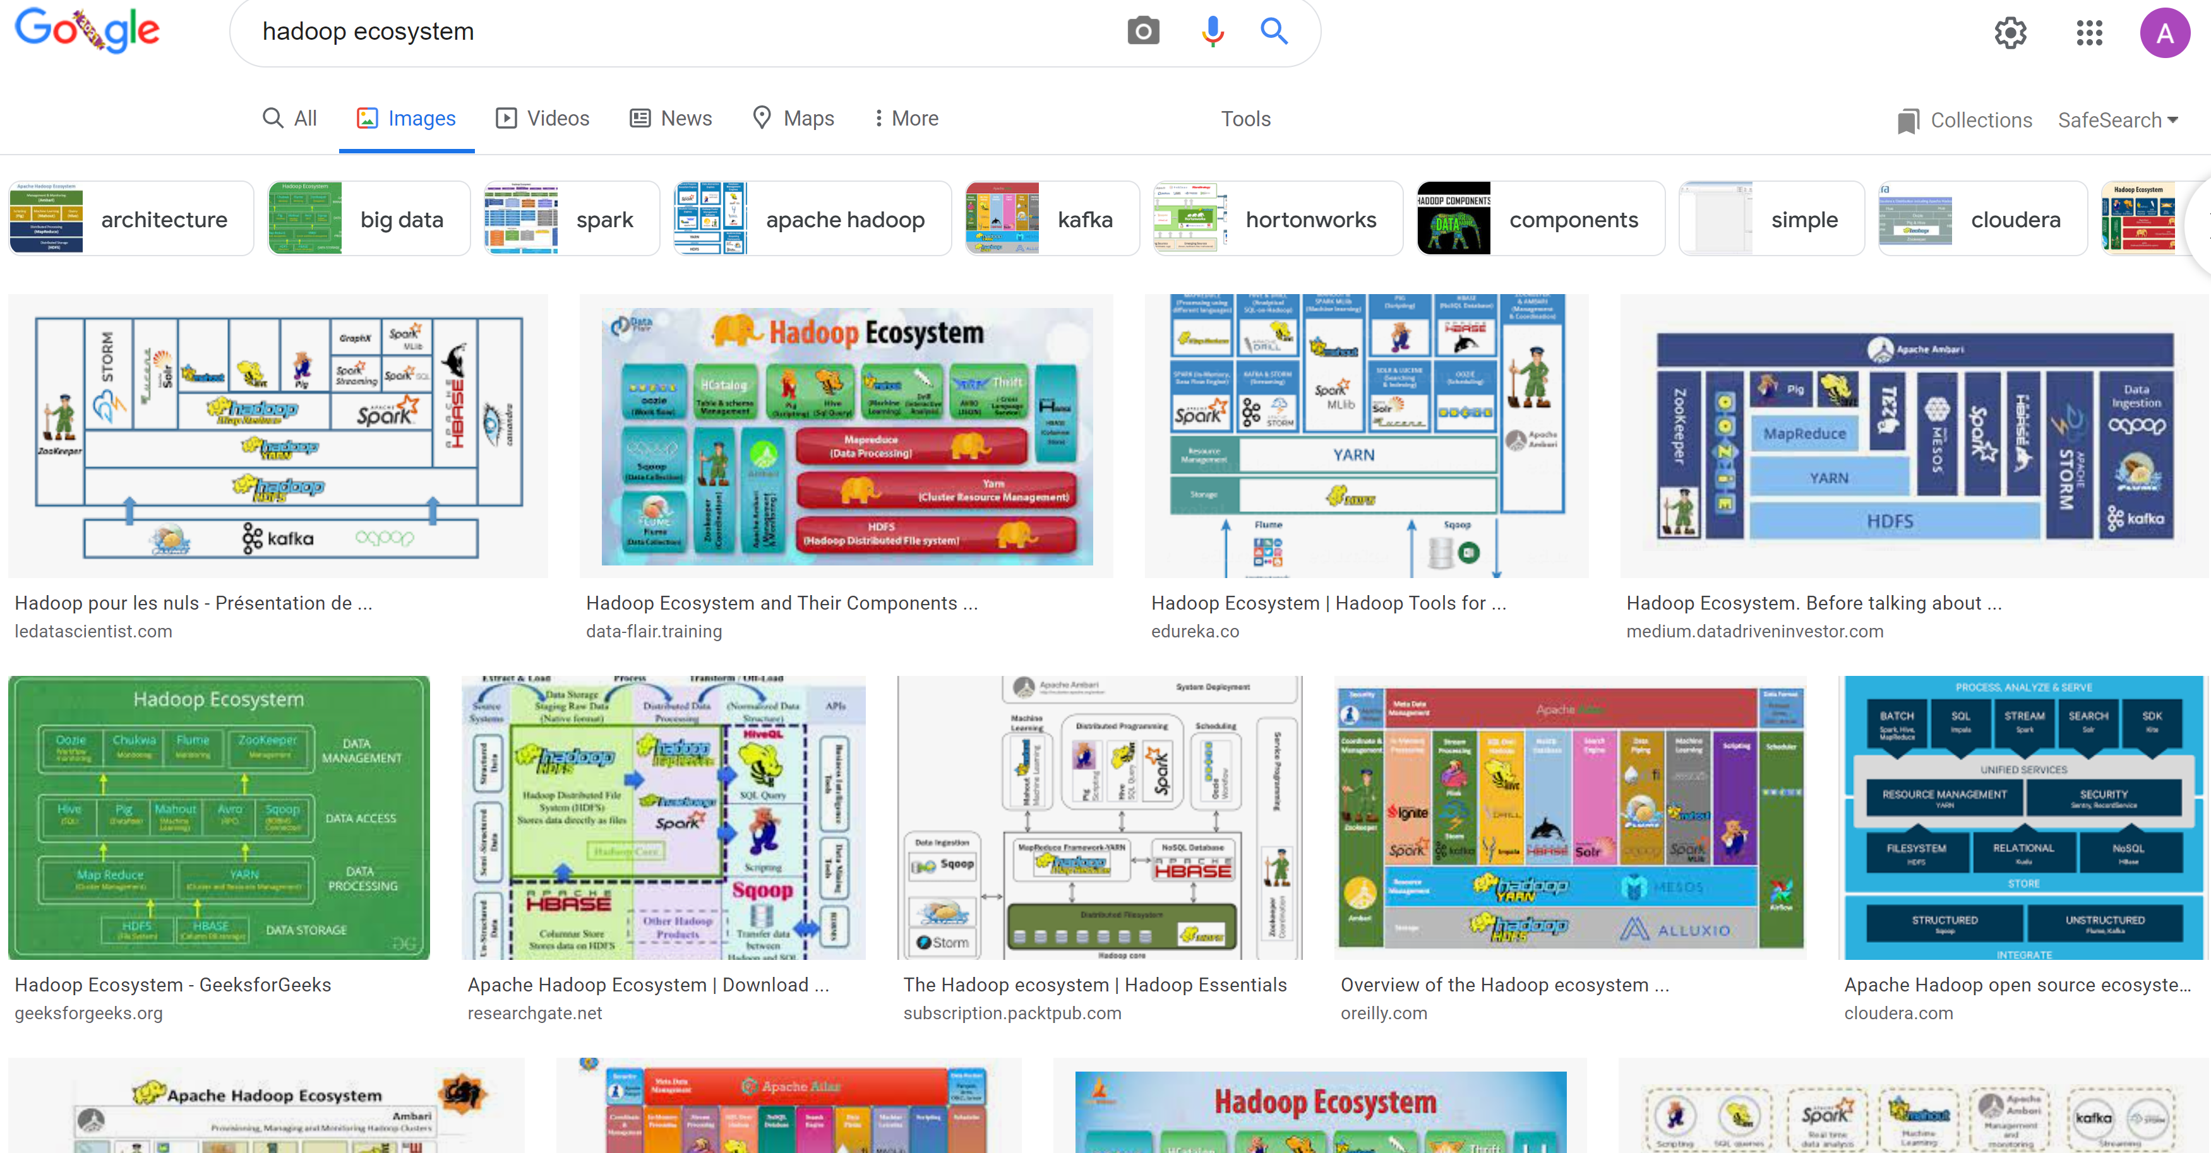
Hadoop Ecosystem « Explosion »

Slide 22





Spark (Recent) History & Ancestors
MapReduce @
2002 @Google
2004 Google
Paper published
2014 Google
No more used of MapReduce
2021 MapReduce bashing
… HDFS & Hadoop also
HortonWork bought by Cloudera HDInsight @Azure…very bad choice
.. To be abandonned
2006 @Yahoo
Hadoop implementation
2012 Yarn (v2)
2008 Apache Open-Source
1995 Message Passing Interface
??
2010 Spark paper
2013 Apache top-level
2015
Kubernetes
2020
Spark on K8s

Slide 23




Datalake History At SG
~2 years ago (2020)
Decision to migrate to Azure
+ Dismantle On-Prem
Dec 2022
OFF
~8 years ago
2014
Init BigData cluster at SGCIB
2 major PROD projects:
- MiFid reports (all trades)
Var Risk
> 150 projects
~ 1 year ago (2021)
>= 100 projects migrate to Azure
Internal Re-organizations
Another Cluster..

Slide 24
Point in common
Despite all changes

Slide 25

MapReduce @Yahoo = Hadoop .. 2006
Commodity Hardwares (datacenters):
Only HDD + RAM
Data Locality : co-host Storage near Compute
use RAM to cache
avoid network
Constraint
=>
Architecture
Choice
Think different?
2006
2020

Slide 26


MapReduce -> Spark + other changes
Faster Disk (SSD)
Faster Network
Compute != Storage
Cloud
Constraint
=>
Architecture
Choice
Think different?
2006
2022

Slide 27















Simple => Many Specific Systems => Unified
“Unified” ecosystem
Simple
+ extensible modules
« Simple » ecosystem
( verbose inneficient & complex java code)
« Bazard » ecosystem
(Too MANY TOO redundant, complexes)

Slide 28

At The end, Only 1 will remain
( French TV Game: Koh-Lanta)

Slide 30
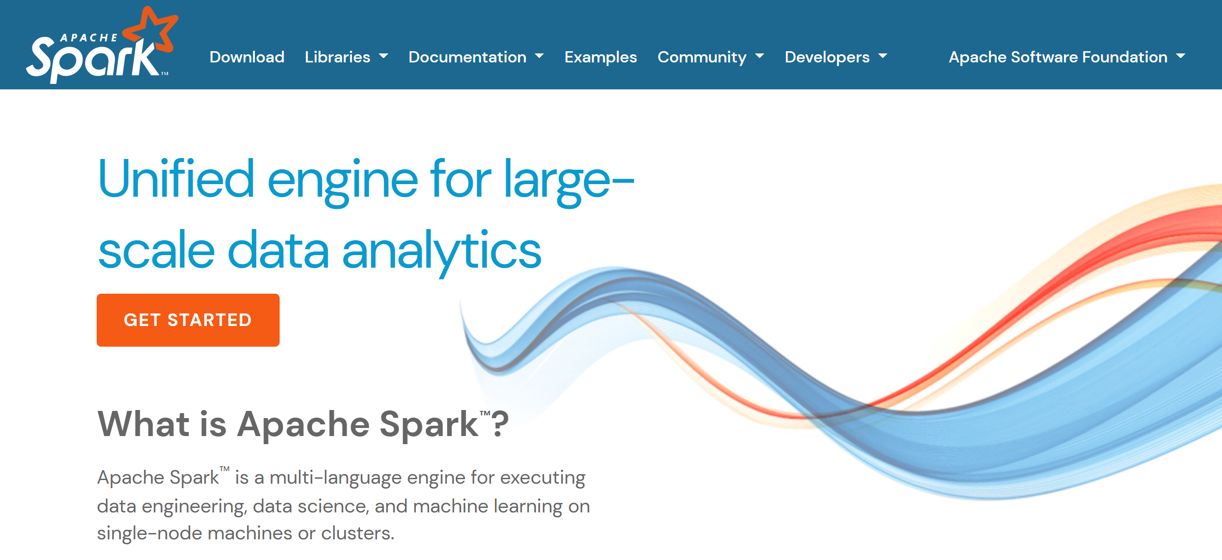
Spark = « Unified Engine »

Slide 31
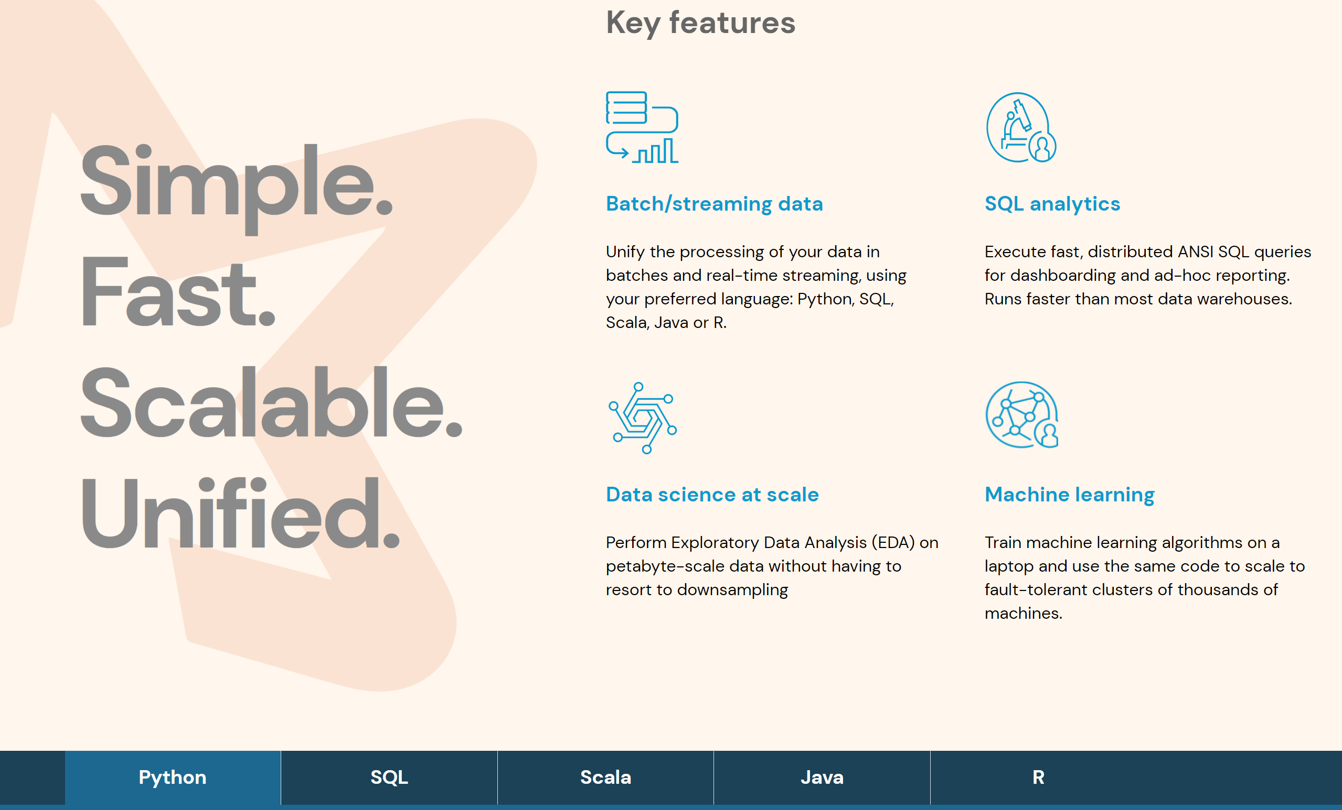
Multi Purposes – Multi Langages

Slide 32


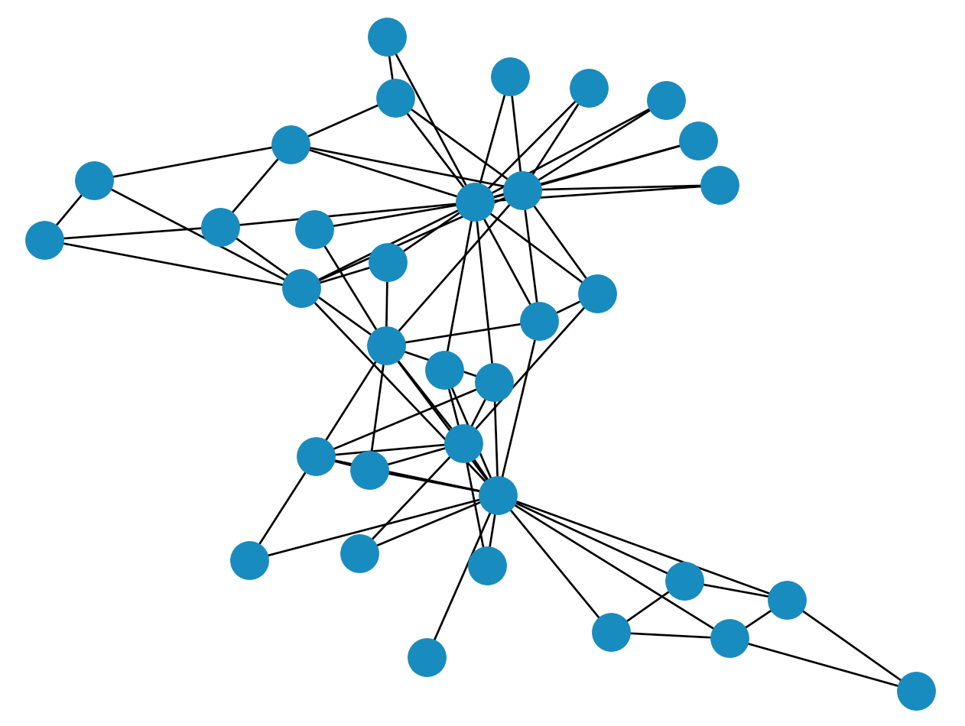









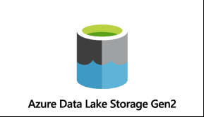






Spark-Core + …
Structured Data
Modules
DataSource Connectors
(Hadoop API)
Cluster Manager
Core
Langages Support

Slide 33
Outline
What is BigData ?
Order of Magnitudes for « Big »
History
Evolution of Softwares, Spark
Description of a Datalake
Content, data feeding
How it is organized
Who uses it
Example of Data-Processing
RAW to LAKE, Reports
Change Storage-Compute, Evolution to Cloud

Slide 34
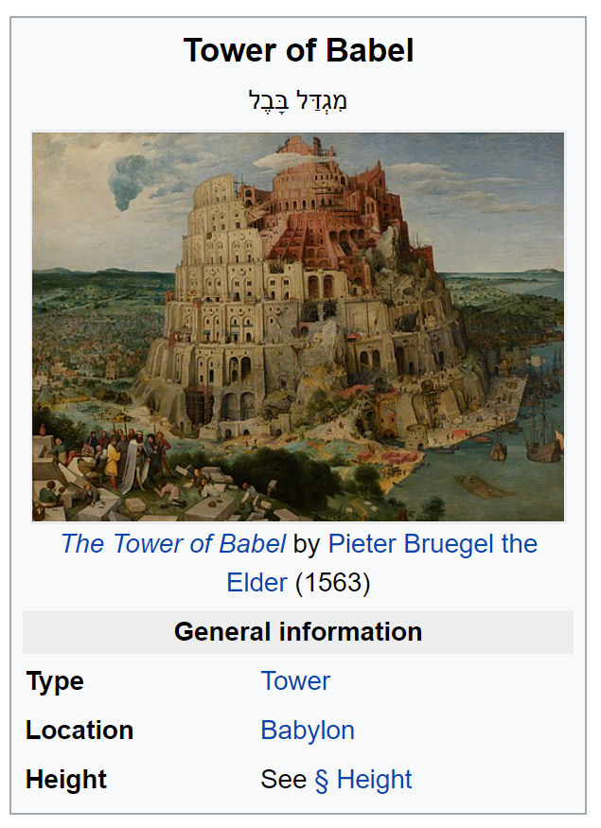
Not Only Machines
~ 200 different Teams / 10 departments
… for 1000 developpers / data engineers / users
In Paris.. But not Only (Bangalore, Montreal, London, New-York, ..)
On ~6000 tables,
described in 1500 DataSets
Lot of Financial / Functional aspects

Slide 35
Feeding Data Inputs to Datalake: aggregating >= 150 Systems
System1:
Referential Data
System2:
Equity Trade
System3:
FixeIncome Trade
System4:
Credit Trade
System N:
MarketData
Computing Var/Risk

Slide 36
Feeding Data / Streaming
BigData at SG is mostly « uploading daily files »
then launching « daily batches »
Many Trade extractions are Real-Time Streaming
… but aggregated in Files per Hours / per Day
Var Computing during night … Huge streaming of events
from dedicated pricing cluster (GPUs)

Slide 37
Feeding Types & Volumetry
Daily batches: upload Files
Teras/day
( millions of files)
Streaming then converted to Files
Streaming to Key-Values Databases
Billions events/day
Peeks to 4000 events/seconds
on each 100 x servers
During 4hours nightly Var batches

Slide 38



Content of a Datalake
FileSystem
= Directories + Files
For batches
Key-Value database
FAST get/put access by single key
Hive Metastore = SQL View
« Table » abstraction for HDFS / Hbase

Slide 39
Storage = Files and Directories
How would you organize
1 Billions Files
in 50 Millions Directories ?
How do you ensure data respect directories organization ?
Try Scanning Directories ?

Slide 40
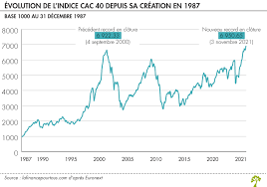
A Very « Simple » Specific Sub-System
« Tick » per seconds
From Market Exchange Places
(Bourse Paris, London Stock Exchange, …)
1 binary file per Day/Place/Instrument
… 2M files per day
… 40 Giga per day
… since 22 years … 25 Billions Files / Petas
Volume, Velocity … but not Variety
( NO spark, No Hadoop )

Slide 41
Governance Data Directories Organization Read-Write Permissions, Quota, RDPG …
How would you organize Read-Write Permissions on 6000 tables x 1000 jobs ?
/ <root HDFS>
/env
/ {raw|lake}
/dir =by Team
/subDir =by domain /sub-subDir=Hive table
/hive partitions /*.parquet
Project ask access
AND describe « Datasets » ( data owner)
=> Validation by DataOffice
=> Create domain sub-dirs + granted recursive WRITE permission
Project ask for a « Usage » Job
Explain Inputs/Output => Validation by DataOffice
=> Grant recursive READ permission for inputs

Slide 42
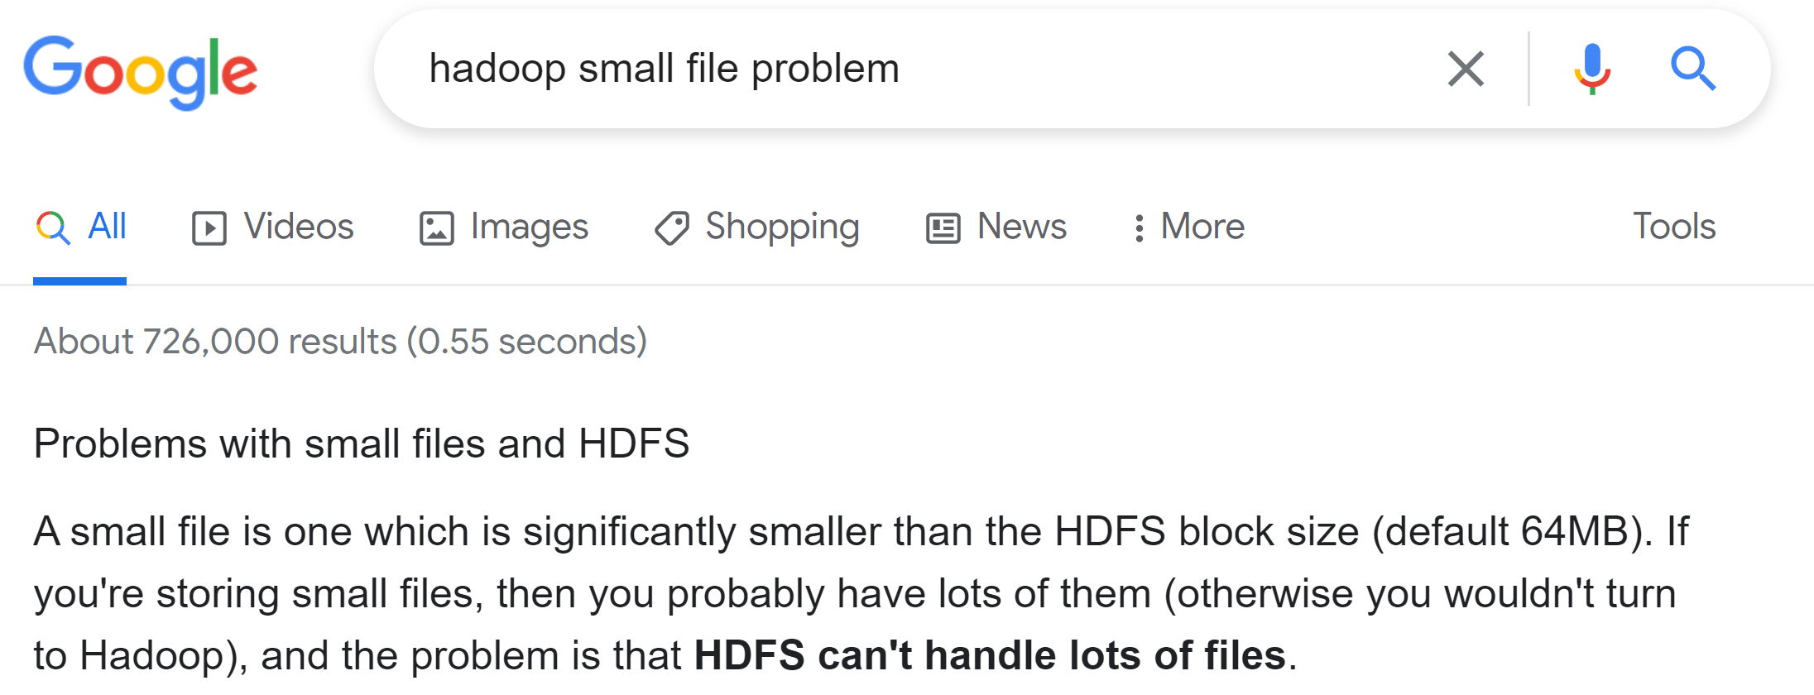
Hadoop hates too many Small Files

Slide 43

BIG Files ? More than Giga ? YES … BUT PARQUET Partitioned
Doing BigData = using PARQUETFiles (correctly with )
End Of Story.

Slide 44
LAKE = Parquet Starting from RAW: Postgresql or {CSV|Json|Avro..} STAGING Dirs
private RAW Layer
sharable LAKE Layer
Upload data
Transform RAW 2 LAKE
PARQUET Files
Postgresql Extract
FTP/Hdfs Files upload
In CSV,Text,Json,Xml,…
Streaming flushed
as Avro Files (Flume)
private APP Layer
Any File format
Example for export to OLAP

Slide 45
Feeding – Transforming – Consuming Data
Project 1
( Feeder only)
Every project is granted 3 Read-Write Databases: RAW, APP, LAKE
LAKE are sharable … designed to be efficiently RE-read after (for analytical)
Every project can request Read access on others LAKE
( after validation by Data-Office )
A Dataset is writable by only 1 Project (the owner )
Project 2
( Feed + Enrich)
Project 3
Project 4
( Transform only)
Project 5
( consume
Only, for reports )

Slide 46
Big Processing
>= 1000 periodic jobs running daily / or every hours
Some processing take >= 15 Hours
Some processing are distributed on more than 200 yarn containers
Some take more than 1000 Go of RAM

Slide 47
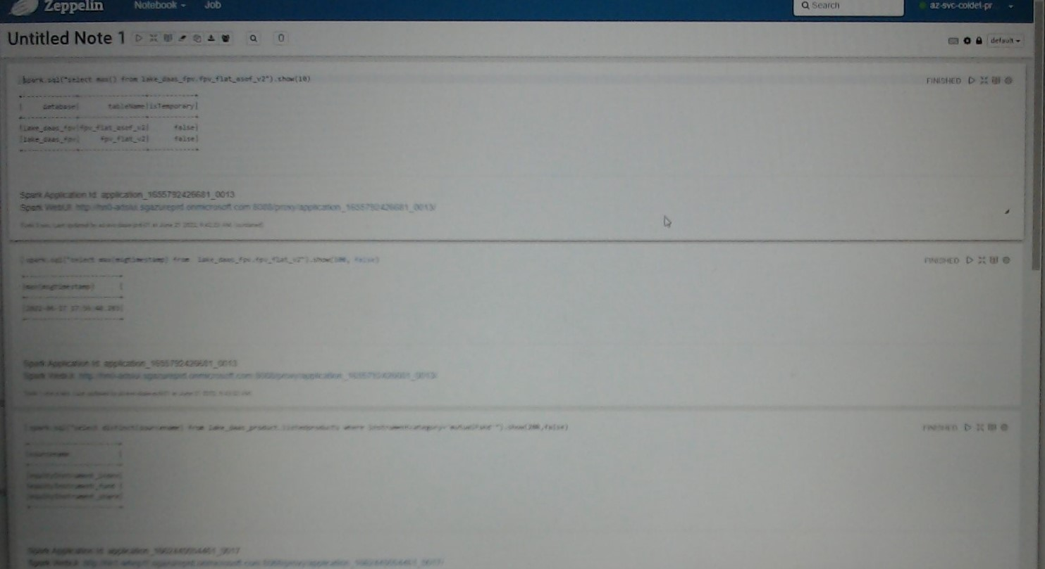
Few Interactive Queries Processing screenshot Zeppelin

Slide 48

Orchestration / DataLineage Data and Workflows are linked

Slide 49
Read-Write Permissions from DataOffice
Dataset « Feeding » declaration:
= exclusive Write Permission : Project -> canWrite -> DB
For validation by DataOffice, DataSet must be described :
confidentiality, source, business owner, quality, RDPG legal
Consumer declaration:
= authorization to read : Project -> canRead -> DB
… for a specific Usage
For validation by DataOffice, use-case must be described,
usage must be « legitimate » , RDI legal

Slide 50
DataLineage Data depends on other Sources Data

Slide 51
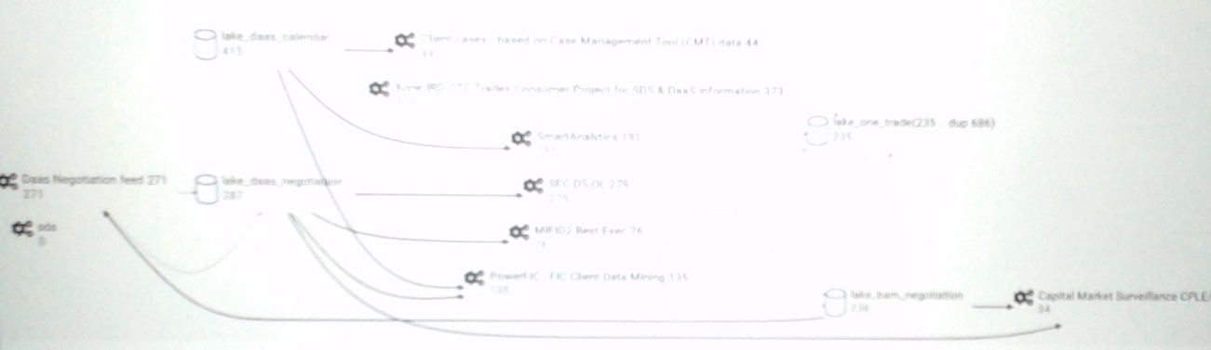
Screenshots (Fuzzy.. On purpose) Read/Write Dependencies Hive Database / Job…
Zooming on 4 out of 250 Hive databases

Slide 52
Orchestration Start process2 after process1 finished
Start condition= CRON 1 * * * * * *
Start condition= Wait for data…
Start condition= CRON 10 * * * * * *

Slide 53
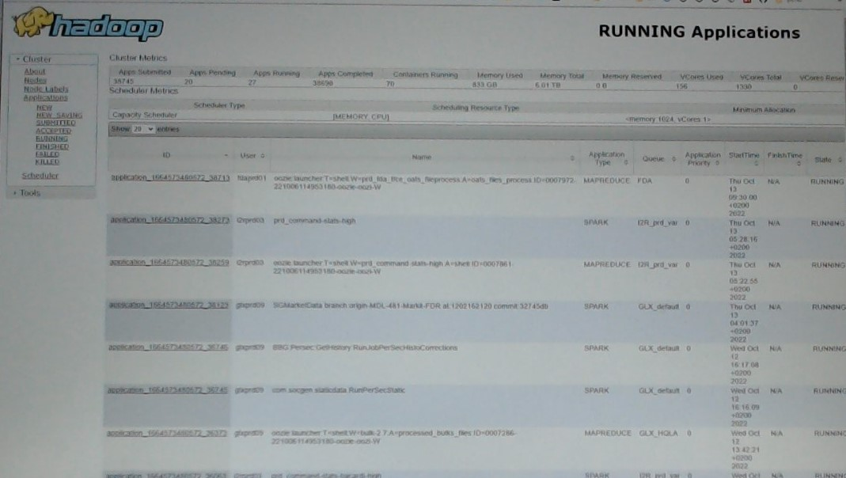

Prod Screenshot (Fuzzy.. on purpose) Running Yarn Applications
MAPREDUCE ?
… only internally to launch shell commands.. To spark
ALL others = SPARK

Slide 54
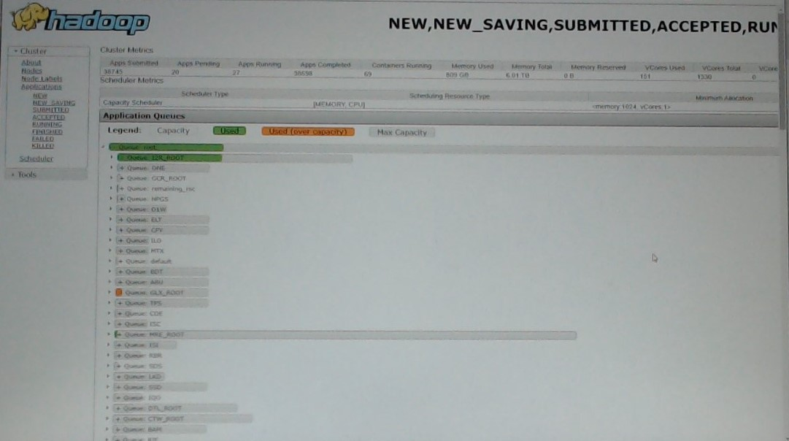
Prod Screenshot : Yarn Queues (Scheduler, CPU+Mem usages)
You see scrollbar?...
Hundreds or Yarn Queues
+ dozen of sub-queues

Slide 55
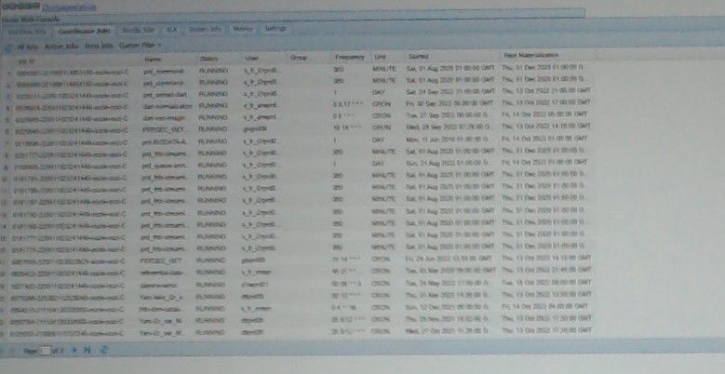
Screenshot Oozie (Coordinators / Workflows)
You see pagination?...
Thousands of CRON jobs
Oozie display only last 50 000 workflows
… so only 2 days of history

Slide 56

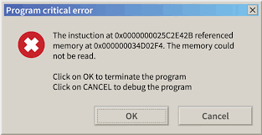
Orchestration « By CRON: 10 * * * * * » Example of Possible Failures
batch1 started at 1 *** … but takes today (anormally) 15h instead of 10h
expected
actual
batch2 started at 12 *** …. data not yet present
=> NO « today » data (only yesterday)
Finished FAST, with NO data
batch2 started, during critical section of batch1 … table dropped/recreated after

Slide 57
Outline
What is BigData ?
Order of Magnitudes for « Big »
History
Evolution of Softwares, Spark
Description of a Datalake
Content, data feeding
How it is organized
Who uses it
Example of Data-Processing
RAW to LAKE, Reports
Change Storage-Compute, Evolution to Cloud

Slide 58
Typical Example of adding 1 daily partition
$ hdfs dfs –mkdir hdfs://raw/team/domain/table/date=2022-10-12
$ hdfs dfs –put localFile hdfs://raw/team/domain/table/date=2022-10-12/
$ spark-sql –master local[1] \
–e « ALTER TABLE raw_lake_domain.table ADD PARTITION ( date=‘2022-10-12’ ) »

Slide 59
Typical RAW to LAKE processing with Spark as Java code
spark.read .format(« csv ») .option(«schema », « col1 type1, … colN typeN ») .load(« hdfs://raw/team/domain/table/date=2022-10-12 ») .map(row -> transformData(row) ) .repartition(3, « col1 ») .sortWithinPartition(« col1, col2, col3 »)
.write .format(« parquet ») .save(« hdfs://lake/team/domain/table/date=2022-10-22 »)
;
read
transform
write

Slide 60
Typical RAW to LAKE processing with Spark as SQL code
write
INSERT OVERWRITE
lake_team_domain.table SELECT /* +REPARTITION(col1, 3) */
col1, col2,
udf_func1(col3, col4) as col3,
udf_func2(col4, col5) as col4,
..
FROM
raw_team_domain.table
JOIN
lake_anotherTeam_domain.anotherTable x ON x.ID=id
WHERE date=‘2022-10-22’ AND ..
SORT BY col1, col2, col3 -- idem sortWithinPartition
transform
read
transform
read
write

Slide 61
Example of LAKE Aggregation
INSERT OVERWRITE
lake_team_domain.table SELECT * FROM (
SELECT * FROM table1 WHERE ..
UNION
SELECT * FROM table2 WHERE ..
UNION
SELECT * FROM table3 WHERE ..
UNION
SELECT * FROM table4 WHERE ..
)
SORT BY col1, col2, col3 -- idem sortWithinPartition

Slide 62
Example of « latest value » cristalisation analytical query « over(partition by) »
INSERT OVERWRITE
lake_team_domain.table SELECT
col1,col2,…. colN -- idem * EXCEPT rank (cf issue SPARK-33164)
FROM (
SELECT *,
RANK() OVER (PARTITION BY id ORDER BY update_time DESC) as rank
FROM lake_team_domain.event_table
)
WHERE rank=1
SORT BY col1, col2, col3 -- idem sortWithinPartition

Slide 63

Example of a « Small » Data Processing resource needed = RAM
Basic Compute
SQL
Select .. where ..
Save Result
Export to OLAP Cube
Enrich « JOIN »
With other tables
Extract all the Trades on perimeter « X »
Since <= 3 Years
Processing on Azure
using cluster 10 x D14 (100 000 euros/year)
ONLY 600 Giga of RAM data …
NOT Enough => Swapping => take 4 Hours

Slide 64
Example of a Slow « Un-parallelized » Processing resource needed = CPU x Time x ..
For each XML, extract
xpath(« a/b/c/d/e ») as column1,
xpath(« a/b/f/g/h ») as column2,
…. as column150,
<XML>
Append to History
(Audit Events)
Appending every day
~1 Avro file, containing
~50 Millions of <XML>..</XML>
~70 Mega bytes
(updates on EquityOption trade description)
Synthesised Latest View

Slide 65
A Slow Processing ?
Legacy « On-Prem »
Daily Batch takes >= 15 Hours
But is mostly SINGLE-THREADED !!!
Some Parallelized intermediate parts take
>= 200 yarn containers … 10% of Cluster
… Result = ULTRA FAST !!
Backported code « as-is » to Azure HDInsight
Used Cluster of 10 x D14 cluster (40 000 euros/month)
Run NEVER Finished
… stopped in « echo count lines before insert $(… ) »
Fully re-implemented in Spark + Java
instead of Hive SQL + UDF xpath
+ Optimized …
Now run in 40 minutes on 2 x D13 cluster

Slide 66
Outline
What is BigData ?
Order of Magnitudes for « Big »
History
Evolution of Softwares, Spark
Description of a Datalake
Content, data feeding
How it is organized
Who uses it
Example of Data-Processing
RAW to LAKE, Reports
Change Storage-Compute, Evolution to Cloud

Slide 67
… More Detailed on « From OnPrem to Azure Cloud » see Document « -cloud.pdf »
Appendix:
Cloud

Slide 68


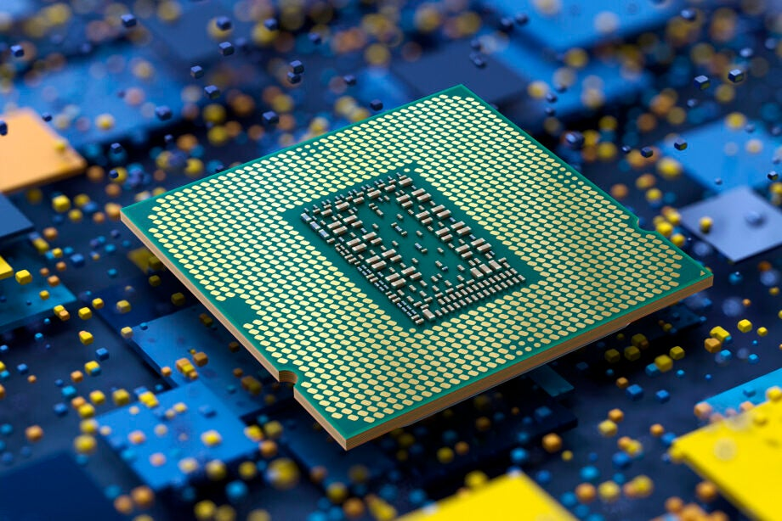

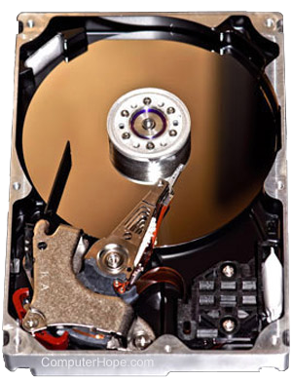
Fundamental Resources TradeOffs
Appendix:
Cloud
Network (Bandwith, Latency)
Development price / Run cost
€€€€€€$$$$$
Horyzontal Scale
CPU (HOT, Watts)
Cold Storage
(SLOW)
Storage (~Small)
RAM (FAST .. Expensive)

Slide 69
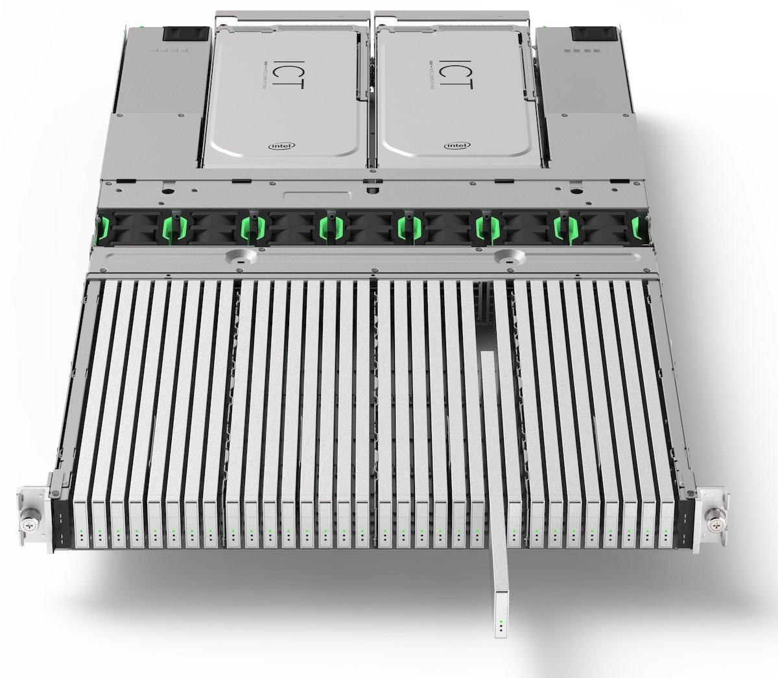
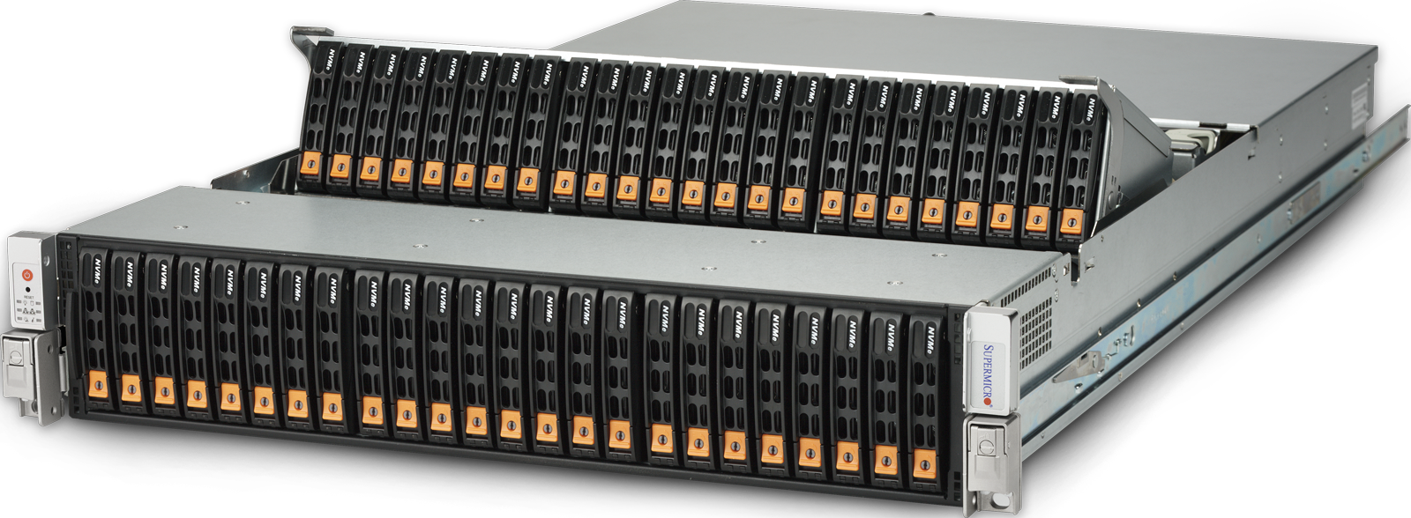
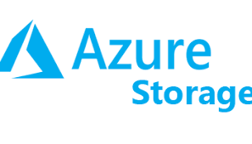
Performance Changes -> Architecture Changes
Appendix:
Cloud
Storage and Compute can be SPLIT … OK !
Higher Density for Huge Storage, lower prices
Historically:
SLOW Disks
Disk Collocated with RAM+CPU
MapReduce « send program » collocated to data
Now:
FAST(ER) SSD Disks + Networks
Can « send» data to distributed programs
48 * disks in 2U blade
1 Peta SSD … 200 000 €
Cloud Provider : AWS, Azure, Google offer Storage solutions (S3, Azure Storage, ..)
+ Managed Services
+ Serverless
+ Kubernetes

Slide 70
Migration to Cloud Azure - AWS - Google
Appendix:
Cloud
Goals:
Elasticity of Storage (No more fear of HDFS FileSystem Full)
Elasticity of Compute (adapt CPU to workload… Pay only what you use)
Clear visibility of cost per Projects / internal refacturation
By-Pass internal IT department
Easier (?) Self-Service API for Provisionning
No More Multi-tenant (no risk of 1 project crashing/consuming whole cluster)
Since 2020 SGCIB is moving its Datalake to Azure

Slide 71
Architecture of Datalake on Clouds
Appendix:
Cloud
Azure Cloud
Azure Tenant
Intranet LAN
Firewall - Restrictions – BluePrint Rules - ..
HUB Network
/ Socks Proxy
Azure Subscription
(per project)
RAW Storage Account
Dedicated ExpressRoute
VM, AKS, HDI ..
VM, AKS, HDI ..
LAKE Storage Account
VM, AKS, HDI ..
VM, AKS, HDI ..

Slide 72
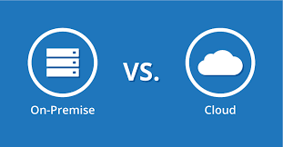
BigData Engineering from OnPrem to Azure
Appendix:
Cloud
Development of custom Yarn/Oozie/Ranger tools
1 Huge cluster, used as Multi-tenant (several users)
Used at 100%
Almost Disk-Full
Many report on disk usage / data purges
Clear view of all Running workloads
(1 Ambari screen)
Lot of Network & Security
Development of Provisionning « sudo » tools
NO more multi-tenant system… but LOT of small clusters
Hundred of clusters, each used at 5% !!!
COST COST COST
Necessity to Optimize Performance
( batches too long… 100x slower / too expensive)
No more Disk worry
… data is growing (no more purges?)
NO admin central view
NO Orchestration of workloads

Slide 73


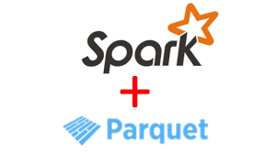

What About Spark in Azure Migration?
Appendix:
Cloud
COST COST COST
Necessity to Optimize Performance
( batches too long… 100x slower / too expensive)
=> Many projects have
migrated + optimized
+ UDF
+
Optimized Spark Reduced memory + Cluster sizes

Slide 74
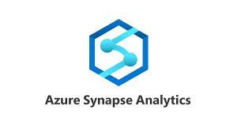


Managed Spark ? Goals: Autoscaling / « serverless »
Appendix:
Cloud
Managed by Azure :
Managed via Kubernetes
databricks
AWS : EMR
GCP : BigQuery

Slide 75
Questions?

Slide 76
Take Away
What is BigData ? Horyzontal Scaling
compute: cluster with Tera of RAM used by Spark apps
storage: Petas of Files, in parquet
What is Spark ?
Simple unified Sql/Java engine
for distributed compute (Yarn/Kube)
distributed storage (HDFS/cloud)
What is Processing ?
mostly spark batches
Feeding RAW
Transforming RAW to LAKE
Consuming SQL analytics
Hadoop ecosystem is complex, Spark brings simplicity
Ecosystem is evolving (Cloud, Kubernetes)

